Slide 1

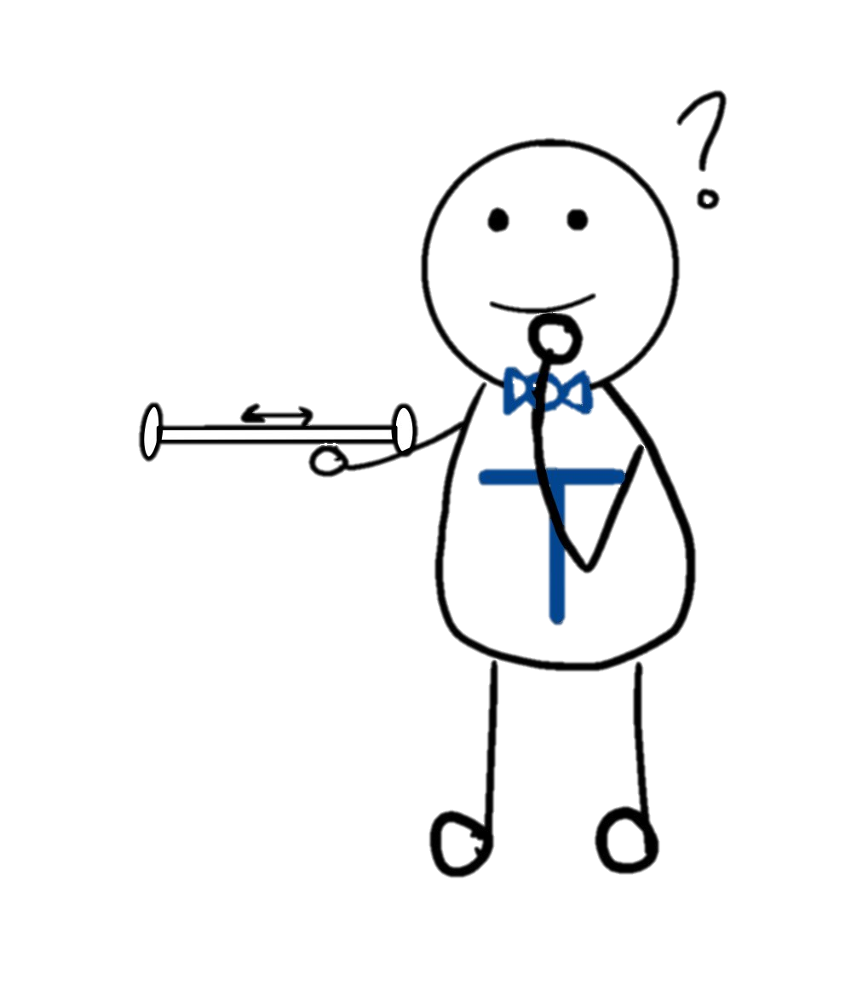


Demo 1 Presentation
Bailey Oteri, Jordie Weber, Trevor Wolf, Daxton Garner
Group 4

Slide 2




Final Objectives:
- Create moving robot using Raspberry PI and Arduino
- Simulating search and rescue robots using arUco markers
- Robot searches unknown area using 6 markers as a path

Slide 3
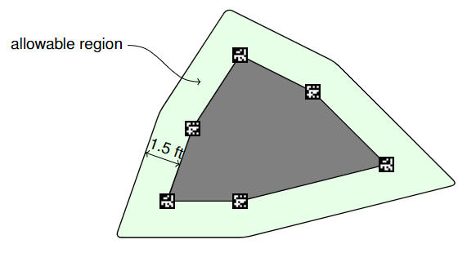

Example Course:
EENG 350: Group 4

Slide 4
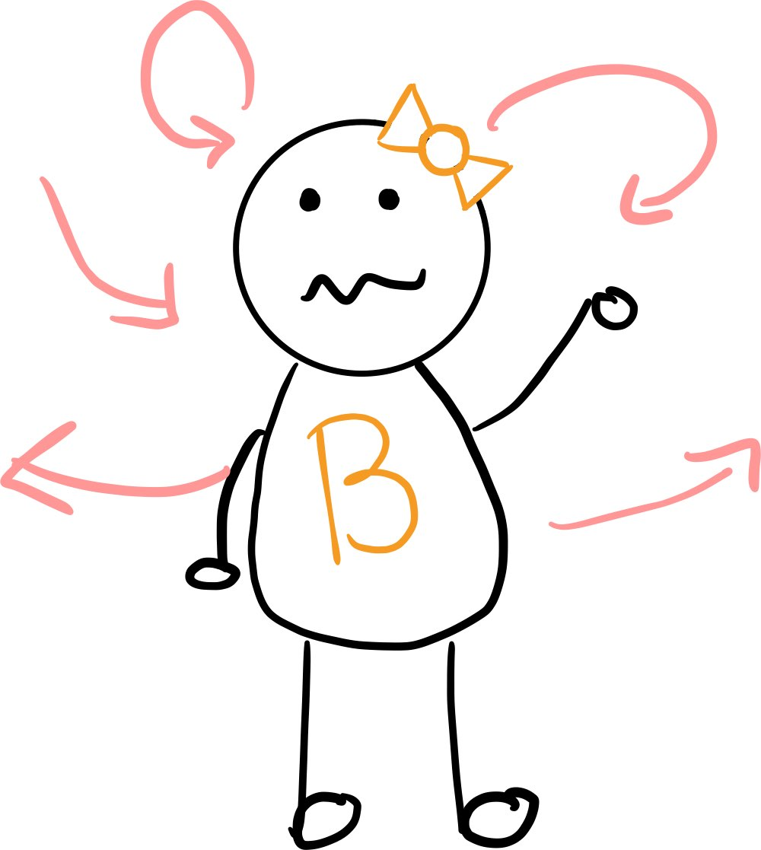


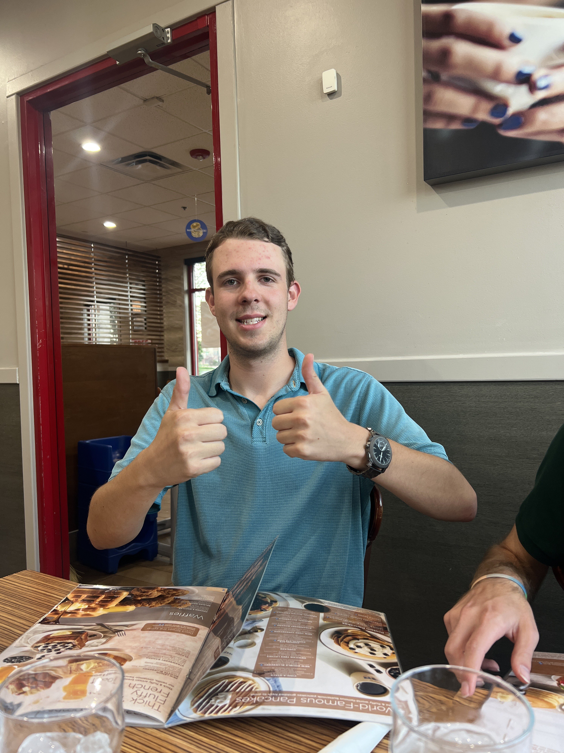

Our Team: Lightning McSEED
Bailey Oteri
Jordie​ Weber
Trevor Wolf​
Daxton Garner
System Integration
Computer Vision
Localization
Control
EENG 350: Group 4

Slide 5

Our Team: Lightning McSEED
Bailey Oteri
Jordie​ Weber
Trevor Wolf​
Daxton Garner
System Integration
Computer Vision
Localization
Control
EENG 350: Group 4

Slide 6

Our Team: Lightning McSEED
Bailey Oteri
Jordie​ Weber
Trevor Wolf​
Daxton Garner
System Integration
Computer Vision
Localization
Control
EENG 350: Group 4

Slide 7

Our Team: Lightning McSEED
Bailey Oteri
Jordie​ Weber
Trevor Wolf​
Daxton Garner
System Integration
Computer Vision
Localization
Control
EENG 350: Group 4

Slide 8
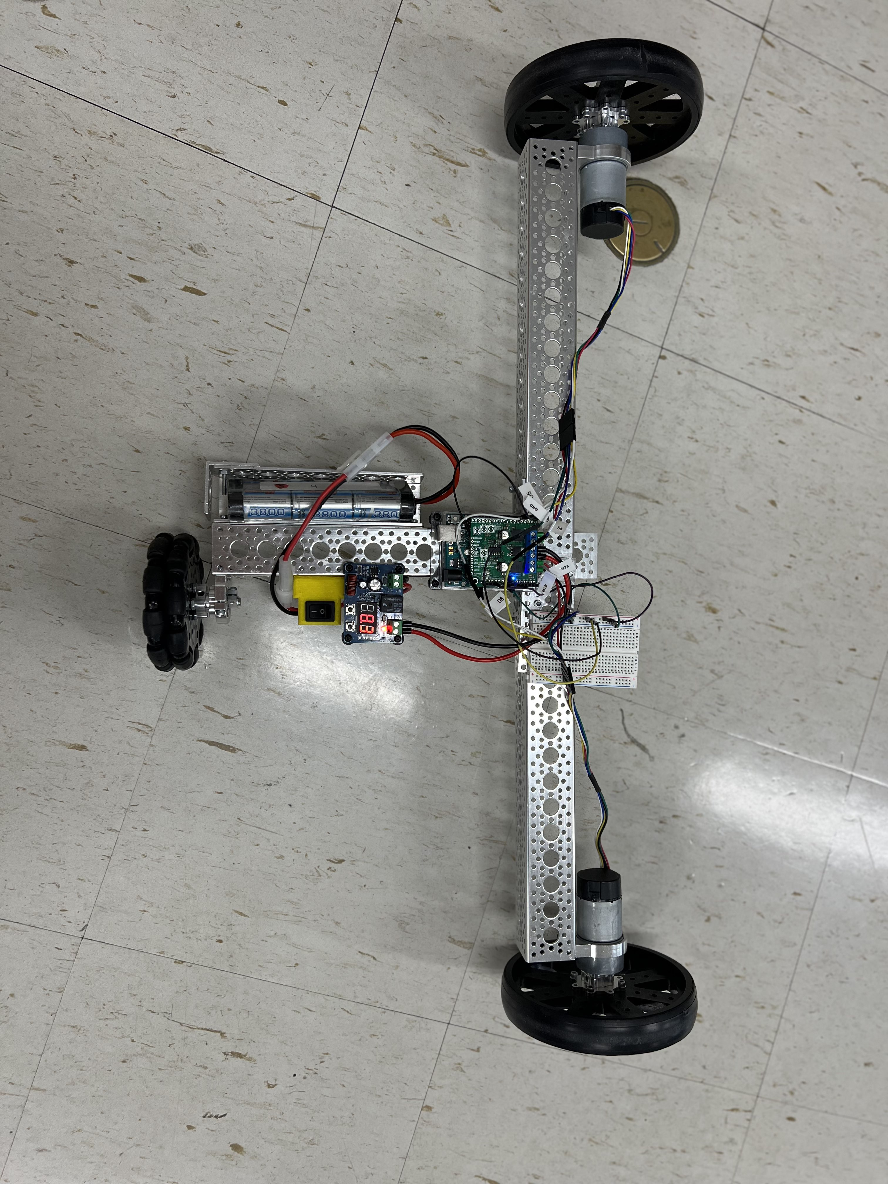

Our Robot!

Slide 9
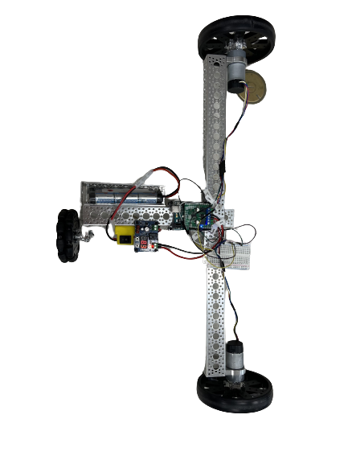

Hardware design–
Demo 1: wider is better
Final Demo: redesigned robot
68.5 cm
EENG 350: Group 4

Slide 10
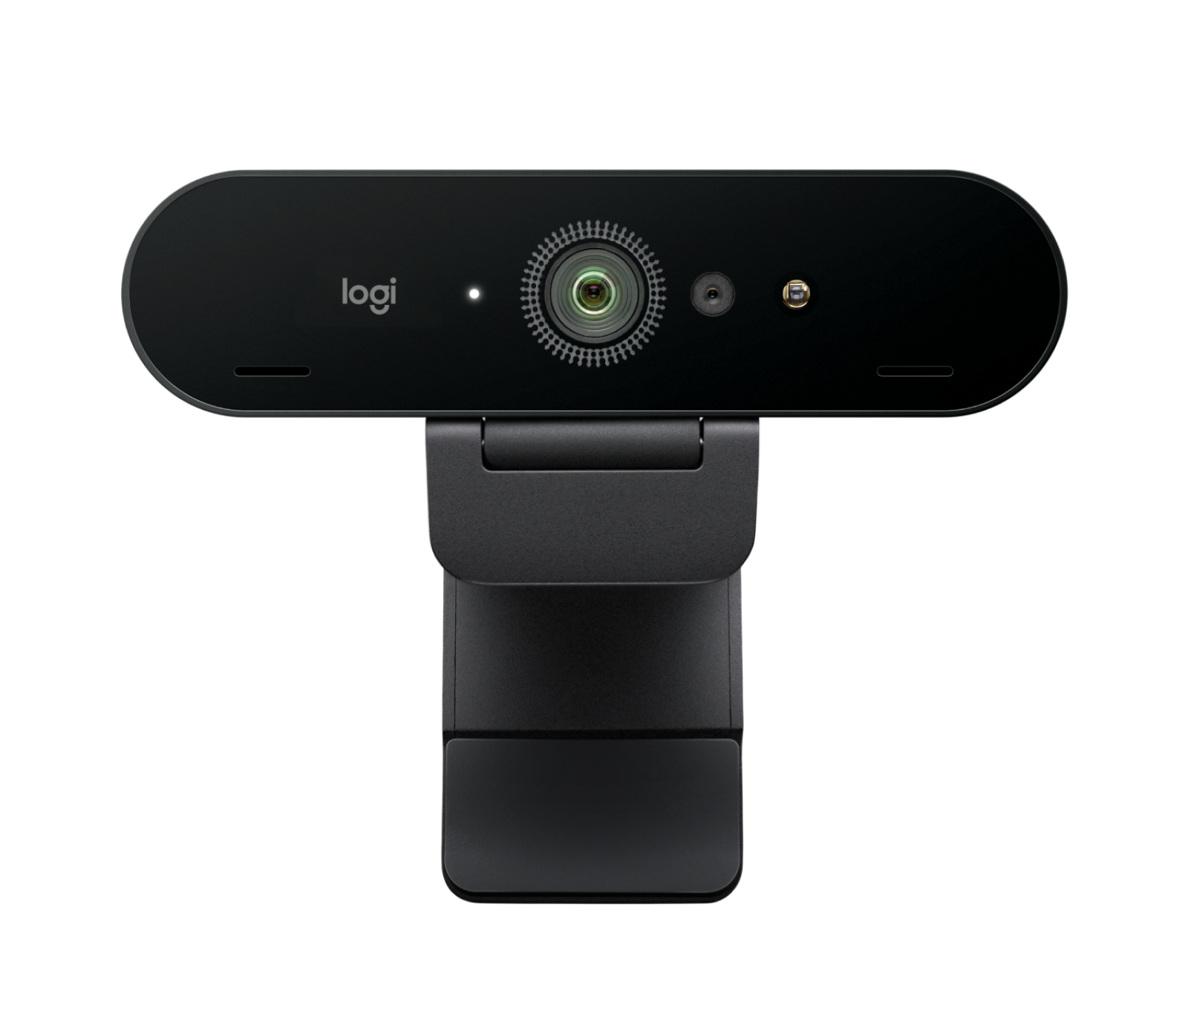

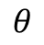
Detection of ArUco markers
Desktop Camera detects ArUco markers
Use trig functions to determine angle between camera and marker
I²C communication from Raspberry PI to Arduino
$$θ$$

Slide 11
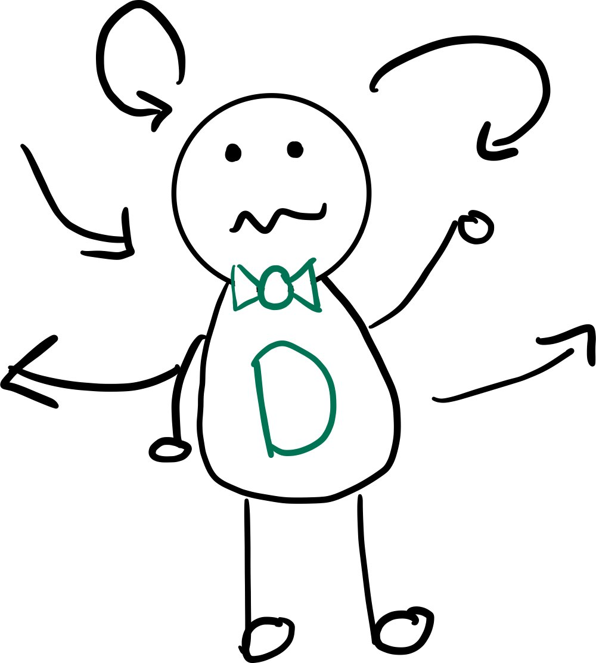
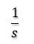
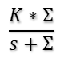
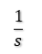
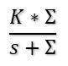
How Arduino controls robot
V_{out}
V_{out}
θd
+-
PI(s)
$$\frac{K∗Σ}{s+Σ}$$
$$\frac{1}{s}$$
_{Iout}
θd
+-
PI(s)
$$\frac{K∗Σ}{s+Σ}$$
$$\frac{1}{s}$$
_{Iout}
Voltage
Velocity
Position
Voltage
Velocity
Position
Position
Position
EENG 350: Group 4

Slide 12
Project Timeline
Final Demonstration
Assignment #1
October 23, 2023
Demo #1
November 10, 2023
Demo #2
December 4, 2023
Integrate parts to explore a single ArUco marker
Detect ArUco marker and find angle between camera and marker
Move robot forward in strait line and rotate by designated radius
Assignment #2
Rotate robot wheel by designated radius specified by PI from location of ArUco marker
Communicate between camera, Raspberry PI, LCD screen, and Arduino
Use the Arduino to send and receive messages and use rotary encoder
September 1, 2023
September 18, 2023

Slide 13


Thank you for watching!
EENG 350: Group 4

